Slide 1
2 Timothy 4:6-8 KJV
⁶ For I am now ready to be offered, and the time of my departure is at hand. ⁷ I have fought a good fight, I have finished my course, I have kept the faith: ⁸ Henceforth there is laid up for me a crown of righteousness, which the Lord, the righteous judge, shall give me at that day: and not to me only, but unto all them also that love his appearing.

Slide 2
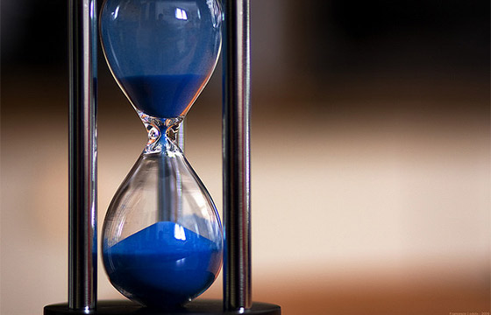
TAKING TIME TO LIVE EVERY DAY FOR CHRIST
Enjoy The Journey!
2 Timothy 4:6-8
www.RandyColeSimsSr.com

Slide 3
INTRODUCTION
The text for our mutual consideration finds Paul imprisoned with a conclusive belief that his death is very near. Although his vantage point is from that of a person looking back over dedicated effort, he speaks to encourage Timothy (as well as today’s readers) that there is reward for a well ran race. A race that Paul has completed and one that he encourages others to complete faithfully that they too might receive the reward!

Slide 4
Ingredients for living every day for Christ
A. Intentional living 2 Timothy 4:6-8 (Ready, set, go)
B. Live faithfully Revelation 2:10 (be faithful)
C. Based on endurance James 1:12 (endurance)
D. Steadfast, unmovable, given fully to the work
(committed) 1 Corinthians 15:58
E. God has priority! Matthew 6:33, Colossians 1:18

Slide 5
Why should I live every day for Christ?
Hold fast that no man takes your crown
Revelation 3:11
B. Run in the race looking to be rewarded
1 Corinthians 9:24
C. Must endure to be saved Matthew 10:22
D. God destroys defiled temples 1 Corinthians 3:17
E. Can fall from grace Galatians 5:4

Slide 6
What is living every day for Christ?
A. Being obedient Ecclesiastes 12:13
B. Living worthy of our calling
Ephesians 4:1-3
C. Being doers of the word (work)
James 1:22
D. Serving with all our heart
Deuteronomy 10:12
E. Serving Fervently Romans 12:11

