Slide 1
2 Timothy 4:1-5
1 I charge thee therefore before God, and the Lord Jesus Christ, who shall judge the quick and the dead at his appearing and his kingdom; 2 Preach the word; be instant in season, out of season; reprove, rebuke, exhort with all longsuffering and doctrine. 3 For the time will come when they will not endure sound doctrine; but after their own lusts shall they heap to themselves teachers, having itching ears; 4 And they shall turn away their ears from the truth, and shall be turned unto fables. 5 But watch thou in all things, endure afflictions, do the work of an evangelist, make full proof of thy ministry.

Slide 2
Does Doctrine Make A Difference?
II Timothy 4:1-5
Emphasis v. 2-4
www.RandyColeSimsSr.com

Slide 3
INTRODUCTION
With so many different things being said, preached, taught, etc. about doctrines and or faiths by different religious organizations, it is a fact according to the Bible that God never desired for us to have the multitude of organizations out there today. Listen to the apostle Paul as he states in Ephesians 4:5 that there is “one Lord, one faith, one baptism.” The Bible is the inspired Word of God II Timothy 3:16-17 - All Scripture is given by inspiration of God, and is profitable for doctrine, for reproof, for correction, for instruction in righteousness, that the man of God may be complete, thoroughly equipped for every good work.” Therefore we need to allow the scriptures (The Word of God, The Bible) to point us in the right direction regarding doctrine.
Are all things taught in line with the scriptures? Are all religious organizations the same as the “church” that Jesus promised to build? (Jesus promised to build one Matthew 16:13-18) When Jesus came into the coasts of Caesarea Philippi, he asked his disciples, saying, Whom do men say that I the Son of man am? 14 And they said, some [say that thou art] John the Baptist: some, Elias; and others, Jeremias, or one of the prophets. 15 He saith unto them, But whom say ye that I am? 16 And Simon Peter answered and said, Thou art the Christ, the Son of the living God. 17 And Jesus answered and said unto him, Blessed art thou, Simon Barjona: for flesh and blood hath not revealed [it] unto thee, but my Father which is in heaven. 18 And I say also unto thee, that thou art Peter, and upon this rock I will build my church; and the gates of hell shall not prevail against it.
If there was ever a time for more than what the Lord intended to be, it would seem that a time of most probable opportunity was seen in Matthew 17:1-5, Mark 9:5-7, and Luke 9:33-35 (at the transfiguration of Jesus Christ). Demonstrate one through the scriptures with the singular terms of the Bible: Matthew 16:18, Colossians 1:18, Ephesians 1:22-23, Ephesians 5:23)

Slide 4
WHAT IS DOCTRINE?
I. What is Doctrine? (II Timothy 4:2)
A. From the Greek, the root word is didache
and means teaching or that which is taught.

Slide 5
DOES DOCTRINE MAKE A DIFFERENCE?
II. Does Doctrine make a difference? (II Timothy 4:3)
A. “they will not endure sound doctrine” 4:3
1. If it’s not sound, what else could there be?
a. “other doctrine” I Timothy 1:3
b. Doctrines that come from or are authored by men
Matthew 15:7-9, Mark 7:7
C. Doctrines of devils I Timothy 4:1
d. Strange doctrine Hebrews 13:9
e. False doctrine is deceptive and causes separation
(v. 9 transgresseth - to go beyond) from Father & Son
II John v. 7-11
1. We are told how to treat those that bring false doctrine
II John v. 10
2. Don’t be a contributor to another’s wrong II John v. 11

Slide 6
DOES DOCTRINE MAKE A DIFFERENCE? CONTINUED
B. Positive examples of Doctrine
1. Sound doctrine Titus 1:9, Titus 2:1,
2. Doctrine that frees us from sin Romans 6:17
a. This doctrine is truth John 8:32, John 17:17
b. we speak what we have been told to speak
(through the Word) I Peter 4:1
1. Example – The Presidents Ambassadors
(we are God’s Ambassadors)

Slide 7
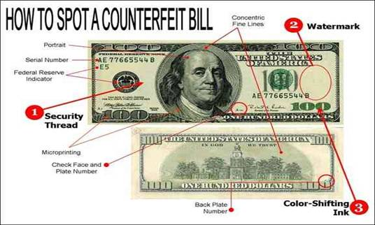

Slide 8
III. Doctrine That Is Original (not counterfeit) Part 1
III. Doctrine That Is Original (not counterfeit)
(Explain how government treasury agents study originals)
A. Communion on the first day of the week Acts 20:7
1. Paul notes the reason we take communion I Cor. 11:23-30
B. Collection “ “ “ “ “ “ “ I Corinthians 16:1-2
C. Recognize that God is awesome Psalm 111:9 (K.J.V.)
D. Sing in the Worship Service Colossians 3:16,
Ephesians 5:19, Matthew 26:30
E. Praying Acts 2:42
F. Preaching II Timothy 4:2

Slide 9
III. Doctrine That Is Original (not counterfeit) Part 2
G. Answering the question of salvation from the scriptures:
1. What must I do to be saved Acts 16:30;
2. Men and brethren, what shall we do Acts 2:37
a. Showing by example what others did to be saved
1. Acts 2 3,000 saved, Acts 8 the eunuch saved,
Acts 16 Lydia’s household saved & Jailor’s household saved
2. The pattern was that they - Heard Romans 10:17, Believed
Hebrews 11:6, Repented Acts 17:30,
Confessed Matthew 10:32-33, Be Baptized Acts 2:38
3. Christ followers / Christians Acts 26:28, I Peter 4:16, Acts 11:26
H. Be like the Bereans, check things out (Acts 17:11) to be sure that
there is no deception by means of counterfeit!

